Slide 1
COVID-19 BY THE NUMBERS
MICHAEL BRADBERRY, ERIK LOCKWOOD, AND NEIL VORA

Slide 2
HOW WE GOT HERE
WHY DID WE CHOOSE COVID 19?
PERSONAL IMPACT
DATA AVAILABILITY
COMPARE FINDINGS TO WHAT IS BEING SAID PUBLICLY
WHAT QUESTIONS WERE WE TRYING TO ANSWER?
WHICH FACTORS OF A GEOGRAPHIC REGION CORRELATE WITH A HIGHER CHANCE OF NEGATIVE OUTCOMES FROM COVID-19?
DOES THE AVAILABLE DATA AND ANALYSIS ALIGN WITH WHAT IS BEING SAID PUBLICLY?
PIVOTING
COUNTY LEVEL ANALYSIS TO STATE LEVEL
POLICY DECISION IMPACTS
WHAT VARIABLES DID WE CHOOSE TO STUDY?
INDEPENDENT
WEATHER (TEMPERATURE)
AGE
TESTING DENSITY/CAPACITY
POLICY DECISIONS/GOVERNMENTAL FACTORS
POPULATION DENSITY
HOSPITAL BED DENSITY
DEPENDENT
# OF CASES
# OF DEATHS
MORTALITY
GOVERNMENTAL RESPONSE TIMES

Slide 3
DATA EXPLORATION AND CLEANUP
DATA SOURCES
JOHNS HOPKINS COVID-19 DATA VIA GITHUB
NEW YORK TIMES ENRICHED COVID-19 DATASET VIA KAGGLE
GEOGRAPHIC CENSUS DATA
GEOGRAPHIC WEATHER DATA
LOCAL GOVERNMENTAL DATA AND DEMOGRAPHIC STATISTICS
STATE GOVERNORS WEBSITES (40+ DIFFERENT SETS OF STATE DATA)
Shor, Boris and Nolan McCarty. “The Ideological Mapping of American Legislatures.” The American Political Science Review 105.3 (2011): 530–551. http://americanlegislatures.com/data/
Jordan, Marty P. and Matt Grossmann. 2020. The Correlates of State Policy Project v2.2. East Lansing, MI: Institute for Public Policy and Social Research (IPPSR).
CHALLENGES
GRANULARITY OF DATA AVAILABLE
EASE OF GATHERING AND AGGREGATING DATA
OVERALL CHALLENGES OF FINDING RELEVANT DATA FOR AN EMERGENT PHENOMENON

Slide 4
HYPOTHESES
VARIABLE (AS THESE INCREASE…) | IMPACT ON # OF CASES | IMPACT ON # OF DEATHS/MORTALITY
AGE
WEATHER (TEMPERATURE)
TESTING DENSITY
CONSERVATIVE ACTIONS
AGGRESSIVE ACTIONS
POPULATION DENSITY
HOSPITAL BED CAPACITY

Slide 5
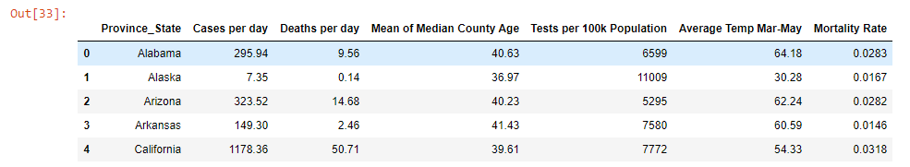
DATA SUMMARY
BY STATE:

Slide 6
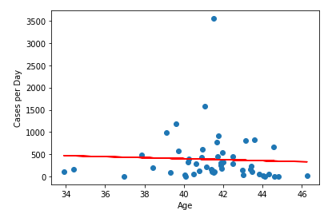
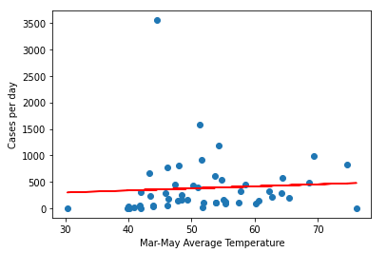
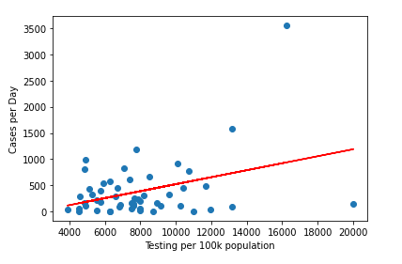
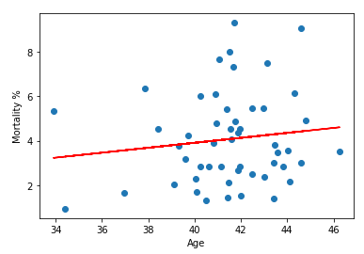
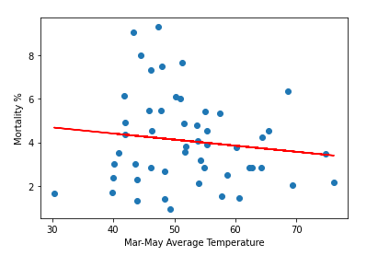
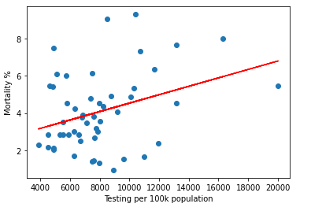
AGE, TESTING DENSITY, AND TEMPERATURE (STATE LEVEL)
AGE
TEMPERATURE
TESTING DENSITY

Slide 7
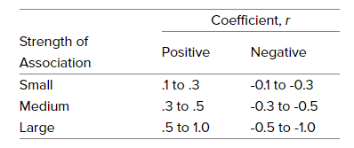
AGE, TESTING DENSITY, AND TEMPERATURE (STATE LEVEL)
VARIABLES BEING ANALYZED | R-VALUE | R-SQUARED VALUE | LINEAR EQUATION
AGE V CASES PER DAY | -.0476 | .0023 | y = -11.28x +855.5
AGE V MORTALITY % | .0165 | .0165 | y = .11x - 0.54
TESTING DENSITY V CASES PER DAY | .3664 | .1342 | y = .07x -141.15
TESTING DENSITY V MORTALITY % | .341 | .1163 | y = .0002x +2.27
TEMPERATURE V CASES PER DAY | .0661 | .0044 | y = 3.90x +185.05
TEMPERATURE V MORTALITY % | -.1298 | .0168 | y = -.28x +5.52
from: Pearson Coefficient Meaning

Slide 8
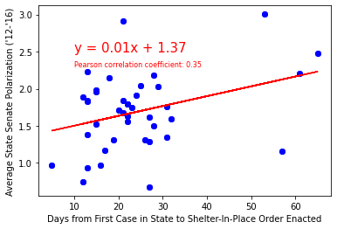
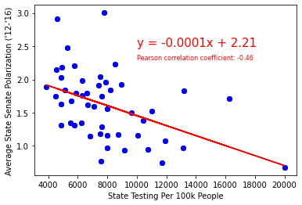
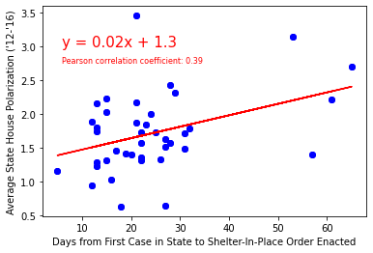
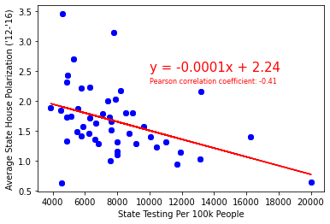
Political Polarization vs. State Action to fight Covid-19
Political Polarization vs. Policy Implementation Lag
Political Polarization vs. State Testing Per-Capita
Graphs C and D to the right show the same y axis scale of political polarization however the x axis of these graphs reflects the cumulative number of Covid-19 tests conducted per 100k people. Here, correlation coefficients of -0.46 and -0.41 respectively indicate a moderate strength of negative correlation between political polarization and state testing levels. it appears that as polarization increases level of testing decreases.
Graphs A & B to the left show the average level of political polarization between 2012 and 2016 within State Senate and House chambers respectively on the y axis. The x axis reflects the cumulative number of days between the first case in a state and that state’s implementation of a shelter-in-place order. Correlation Coefficients of 0.35 and0.39 respectively indicate some positive correlation between degree of polarization and lag time in implementing a shelter in place order. It appears that as polarization increases delay in implementation of a shelter in place order also increases.
A
C
B
D
CONCLUSION: If the lag time to, and magnitude of, Covid-19 response policy implementation is taken as a measure of government effectiveness then the moderate strength of correlation on the above graphs indicates that political polarization may have some negative impact on a state’s Covid-19 response effectiveness.
https://americanlegislatures.com/data/

Slide 9
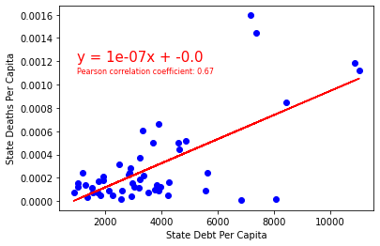
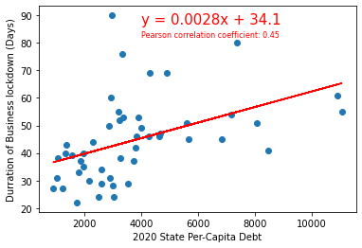
State Debt per Capita vs. Business Closures & Deaths
State Deaths vs Debt (Normalized for Population)
Duration of Lockdown vs State Per-Capita Debt
The above chart reflects state deaths per-capita along the y axis and state debt per-capita along the x axis. a correlation coefficient of 0.67 indicates a moderately strong positive correlation between the indebtedness of a state and the number of deaths when both debt and deaths are normalized for differences in state population.
(The correlation coefficient between a state’s absolute level of debt and per-capita deaths is 0.57 and the correlation coefficient between a state’s per-capita debt and total deaths is 0.38.)
There appears to be a moderate positive correlation between the duration of a state’s lockdown and a states per-capita debt. Originally we hypothesized that states with more debt would be inclined to enact more brief lockdowns to mitigate further economic damage resulting in a negative correlation. However the opposite direction of correlation suggests an interesting counterfactual hypothesis that states with a higher tolerance for debt may be willing to enact longer duration lockdowns in spite of potential economic costs.

Slide 10
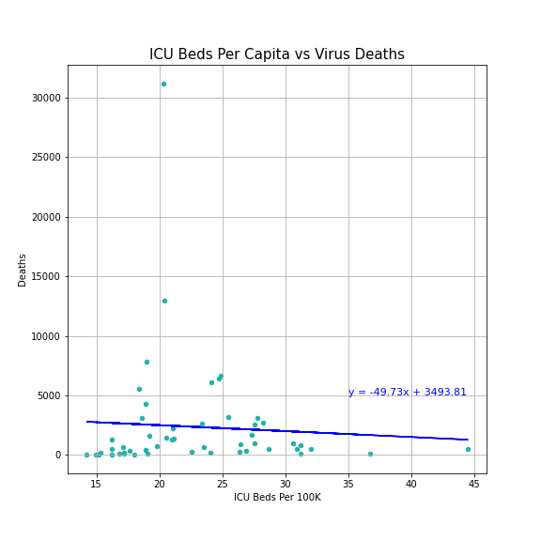
Do more ICU beds translate into fewer virus deaths?
r-value = -0.06, r-squared = 0
Weak, negative correlation between # of ICU Beds per capita and numbers of deaths
Though ICU beds undoubtedly have saved some lives, the virus still can prove fatal even with intensive care.
Other factors like age, pre-existing health disorders, immune system deficiency, and sheer number of cases all factor into virus deaths.
This variable will likely prove more impactful if hospitals begin to reach capacity constraints.

Slide 11
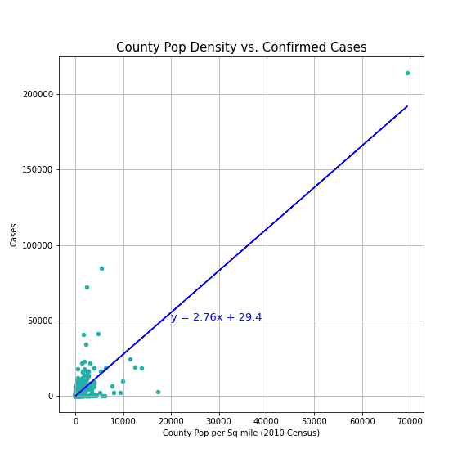
How does population density relate to virus spread?
r-value = 0.83, r-squared = 0.69
Strong correlation shown between population density by county and # of confirmed cases as anticipated

Slide 12
CONCLUSION/RESULTS
WEATHER, AGE, TESTING DENSITY, ICU BEDS
VARIABILITY (r^2) IN CASES & MORTALITY PROVED TO BE VERY WEAKLY IMPACTED BY THESE VARIABLES
LIMITATIONS
STATE LEVEL DATA
LACK OF LARGER BIN STRATIFICATION
POLICY DECISIONS/GOVERNMENTAL FACTORS
POLITICAL POLARIZATION MAY HAVE SOME IMPACT ON STATE GOVERNMENT’S RESPONSE TO COVID-19.
STATE PER-CAPITA DEBT MAY HAVE A MODERATE IMPACT ON PER-CAPITA MORTALITY RATES
STATES WITH A HIGHER TOLERANCE FOR DEBT MAY BE WILLING TO EXTEND BUSINESS LOCKDOWNS LONGER
POPULATION DENSITY
AS HYPOTHESIZED, POPULATION DENSITY PROVED AS A LEADING IMPACTFUL FACTOR IN OVERALL VIRUS CASE NUMBERS

Slide 13
FUN EXTRAS (PRACTICAL APPLICATIONS OF THE DATA)

